Slide 1

ADICHUNCHANAGIRI INSTITUTE OF TECHNOLOGY,CHICKMAGALUR
DEPARTMENT OF INFORMATION SCIENCE AND ENGINEERING
INTERNSHIP SEMINAR
ON
“USAGE OF GITHUB FOR DEVOPS”
Under the guidance of : Presented By :
Mrs.Deepashri K S Shubha H T (4AI19IS047)
Associate Professor,
Department of IS & E

Slide 2
CONTENTS
ABSTRACT
INTRODUCTION
PROBLEM STATEMENT
OBJECTIVES
IMPLEMENTATION
RESULTS AND DISCUSSIONS
CONCLUSION AND FUTURE ENHANCEMENT

Slide 3
ABSTRACT
The collection and mining of GitHub data , aiming to understand GitHub user behaviour.
Creation of repositories with respect to various dimensions. Only one person from authors is contributing to the repositories.
GitHub is a code hosting platform for version control and collaboration. It will let the users to work togeather on projects from anywhere.
GitHub makes it easy for developers to share code files and collaborate with fello developers on open-source projects.
GitHub serves as a social networking site where developers can openly network, collaborate, and pitch their work.

Slide 4
INTRODUCTION
GitHub is a platform for the creation of account to upload files and create repositories. But the real work of GitHub happens when users begin to collaborate.
In GitHub anyone can code independently, teams of people build most development projects. Sometimes these teams are all in one place at time, but more often they work asynchronusly.
Forking creates copy of the others repository into personal account.
Cloning makes a local copy of repository.

Slide 5
PROBLEM STATEMENT
The main aim of the project is to create public and private files or to upload file in repository of GitHub also edit the content of the files, Renaming the files and to provide multiple-user access of the files on the same project.
Input: The files, documents and branch given as an input by the user.
Processing: It focuses on branching and makes it possible for teams experiment freely. The public and private files will be created or existing projects and files will be uploaded to repository and commit.
Output: Created or the uploaded files will be documented in the repositories of GitHub.

Slide 6
OBJECTIVES
To provide robust version control features that allows the developers to track changes made in their over time.
To allow the developers to work togeather on the same codebase providing tools for code review.
To provide tools for managing software devolopment projects including issue tracking.
To integrates with a wide range of other tools and services, making it easy to automate workflow.

Slide 7
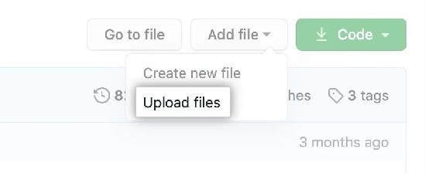
IMPLEMENTATION
Adding files to repository
GitHub.com, navigate to the main page of the repository.
In your repository, browse to the folder where you want to create a file.
Above the list of files using the Add file drop-down, click Create new file. "Create new file" in the "Add file" dropdown

Slide 8
IMPLEMENTATION
At the bottom of the page, type a short, meaningful commit message that describes the change you made to the file. You can attribute the commit to more than one author in the commit message. For more information, see "Creating a commit with multiple authors."
Click commit changes.

Slide 9
IMPLEMENTATION
Debugging
Simple files can be uploaded by using drag and drop method.
Error in uploading complex files and Projects.
Alternative method for uploading complex files using Command lines.

Slide 10
IMPLEMENTATION
ADDING FILE TO REPOSITORY USING THE COMMAND LINE
On your computer, move the file you'd like to upload to GitHub into the local directory that was created when you cloned the repository.
Open Git Bash.
Change the current working directory to your local repository.
Stage the file for commit to your local repository.
$ git add .
# Adds the file to your local repository and stages it for commit. To unstage a file, use 'git reset HEAD YOUR-FILE'.
Commit the file that you've staged in your local repository.
$ git commit -m "Add existing file"

Slide 11
IMPLEMENTATION
Push the changes in your local repository to GitHub.com.
$ git push origin YOUR_BRANCH
# Pushes the changes in your local repository up to the remote repository you specified as the origin
EDITING FILES CONTENT IN YOUR REPOSITORY
In your repository, browse to the file you want to edit.
In the upper right corner of the file view, click to open the file editor.

Slide 12
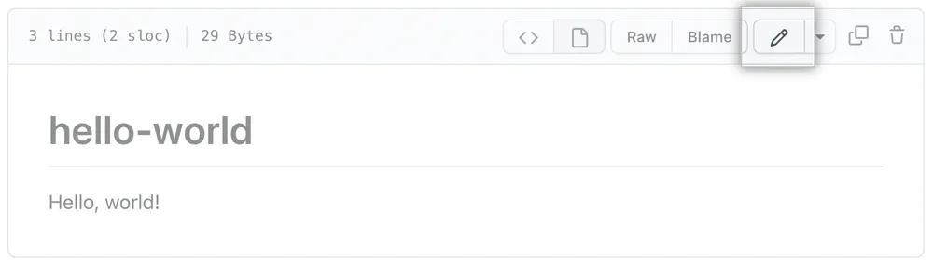
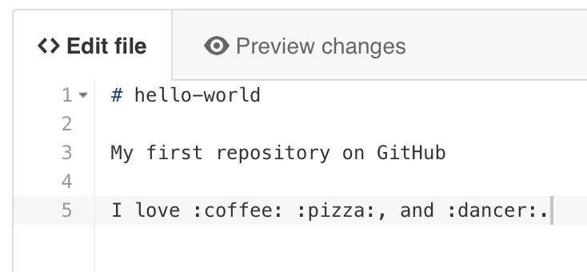
IMPLEMENTATION
EDITING FILES CONTENT IN YOUR REPOSITORY
In your repository, browse to the file you want to edit.
In the upper right corner of the file view, click to open the file editor.
On the edit file tab , make any changes you need to the file.

Slide 13
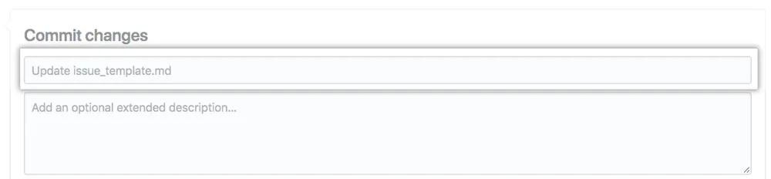
IMPLEMENTATION
At the bottom of the page, type a short, meaningful commit message that describes the change you made to the file. You can attribute the commit to more than one author in the commit message. For more information, see "Creating a commit with multiple authors."

Slide 14
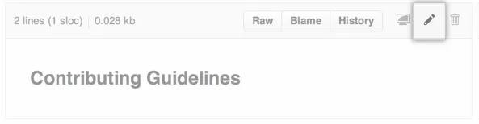
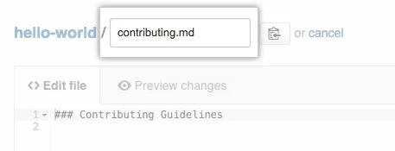
IMPLEMENTATION
RENAMING A FILE IN GITHUB
In your repository, browse to the file you want to rename.
In the upper right corner of the file view, click to open the file editor.
In the filename field, change the name of the file to the new filename you want. You can also update the contents of your file at the same time.

Slide 15
IMPEMENTATION
At the bottom of the page, type a short, meaningful commit message that describes the change you made to the file. You can attribute the commit to more than one author in the commit message. For more information, see "Creating a commit with multiple authors."

Slide 16
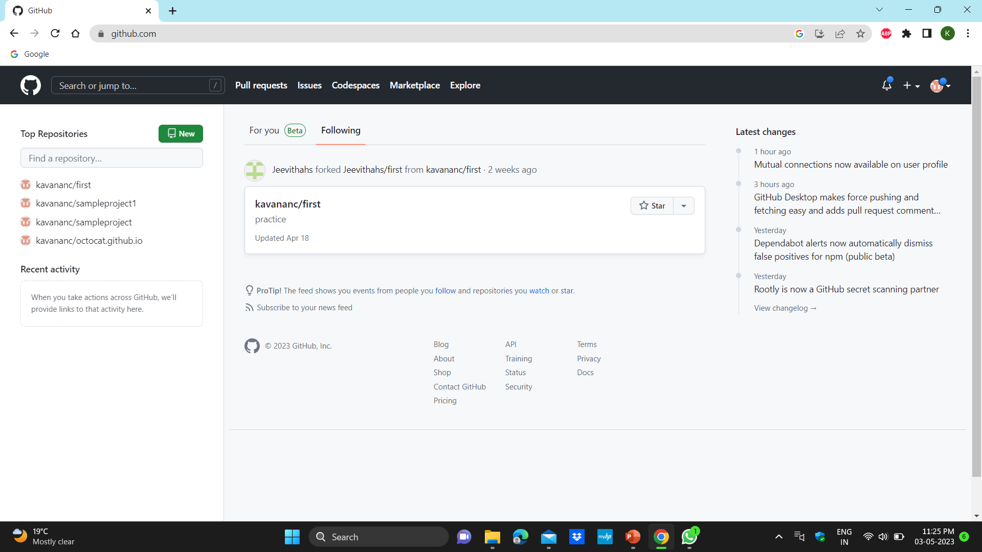
RESULTS AND DISCUSSIONS
FORKING OF THE REPOSITORY
Snapshot 1 : Homepage of GitHub.

Slide 17
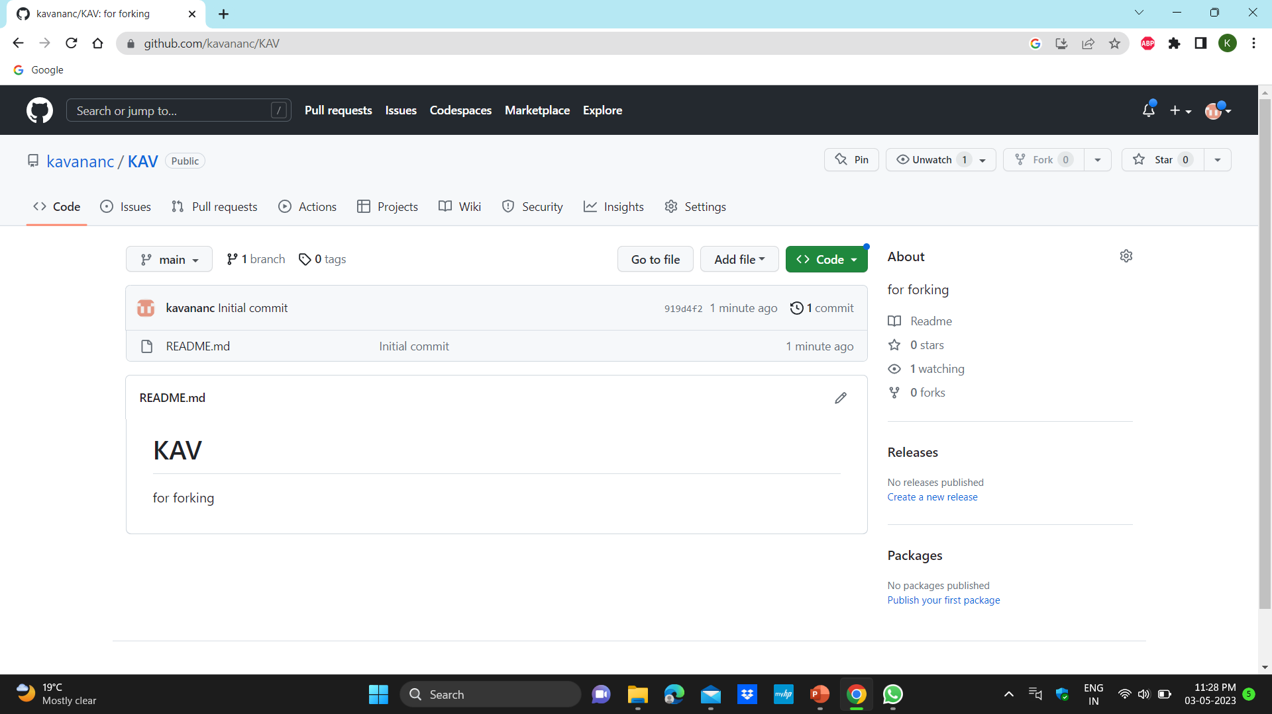
RESULTS AND DISCUSSIONS
Snapshot 2 : Forking of the repository.

Slide 18
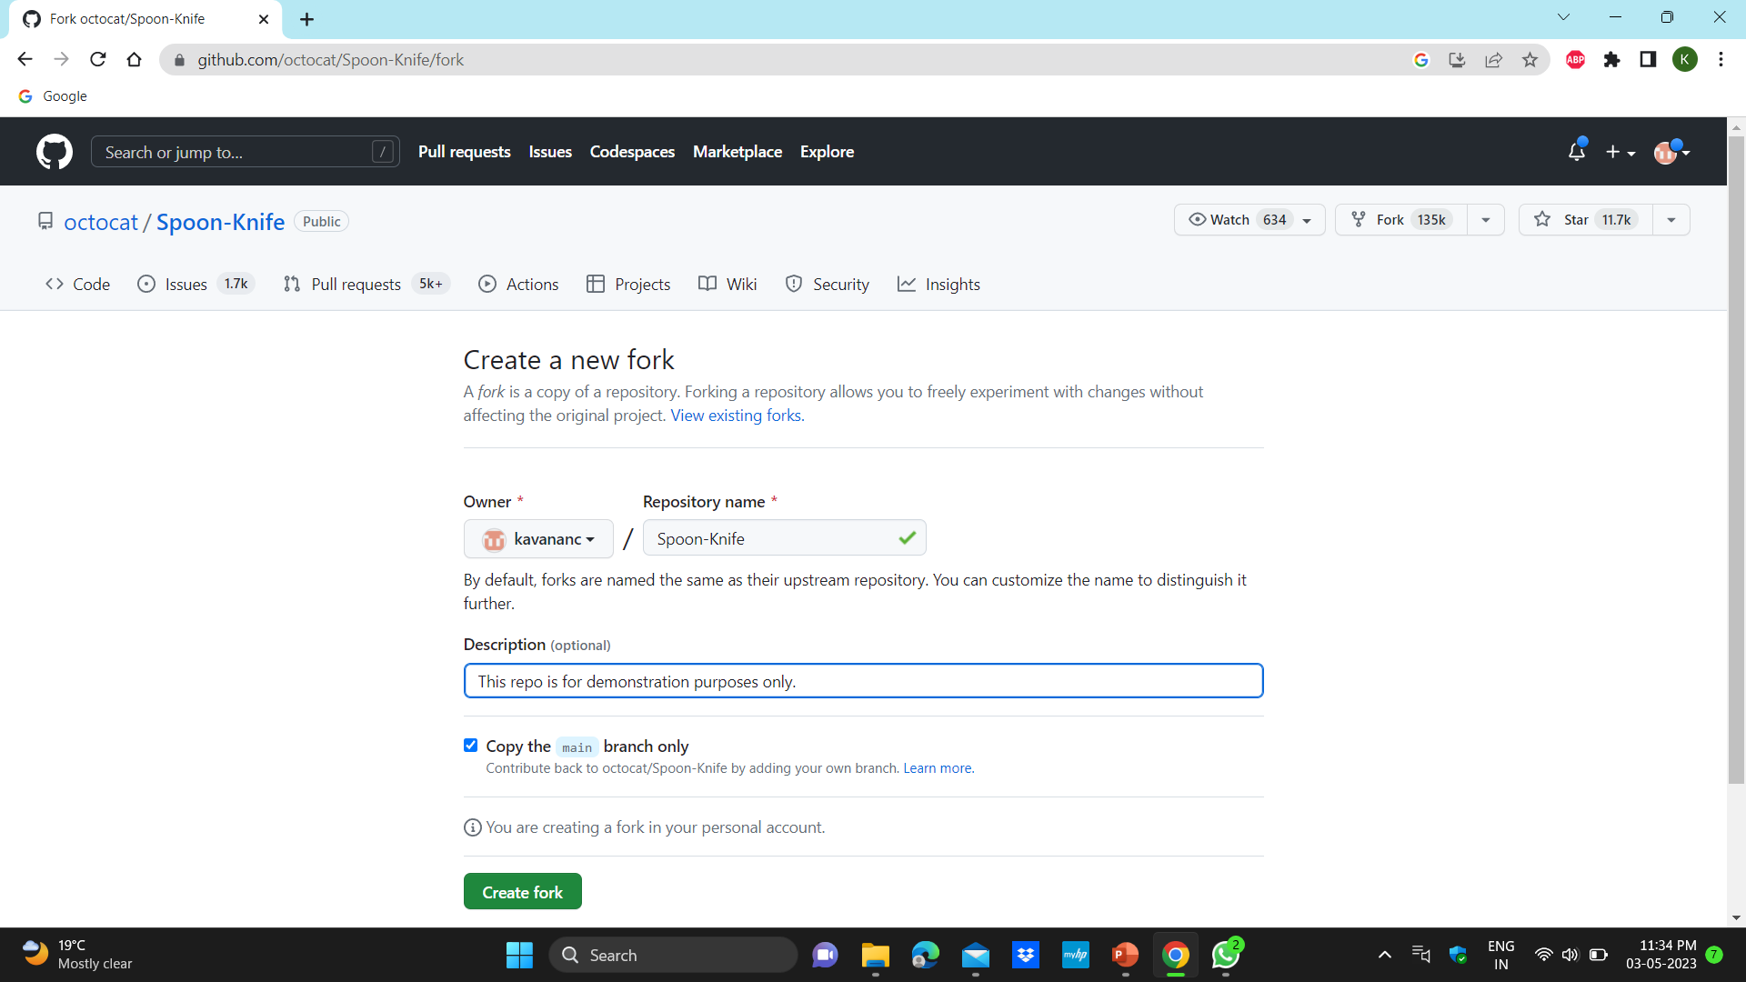
RESULTS AND DISCUSSIONS
Snapshot 3 :Select an owner for the forked repository.

Slide 19
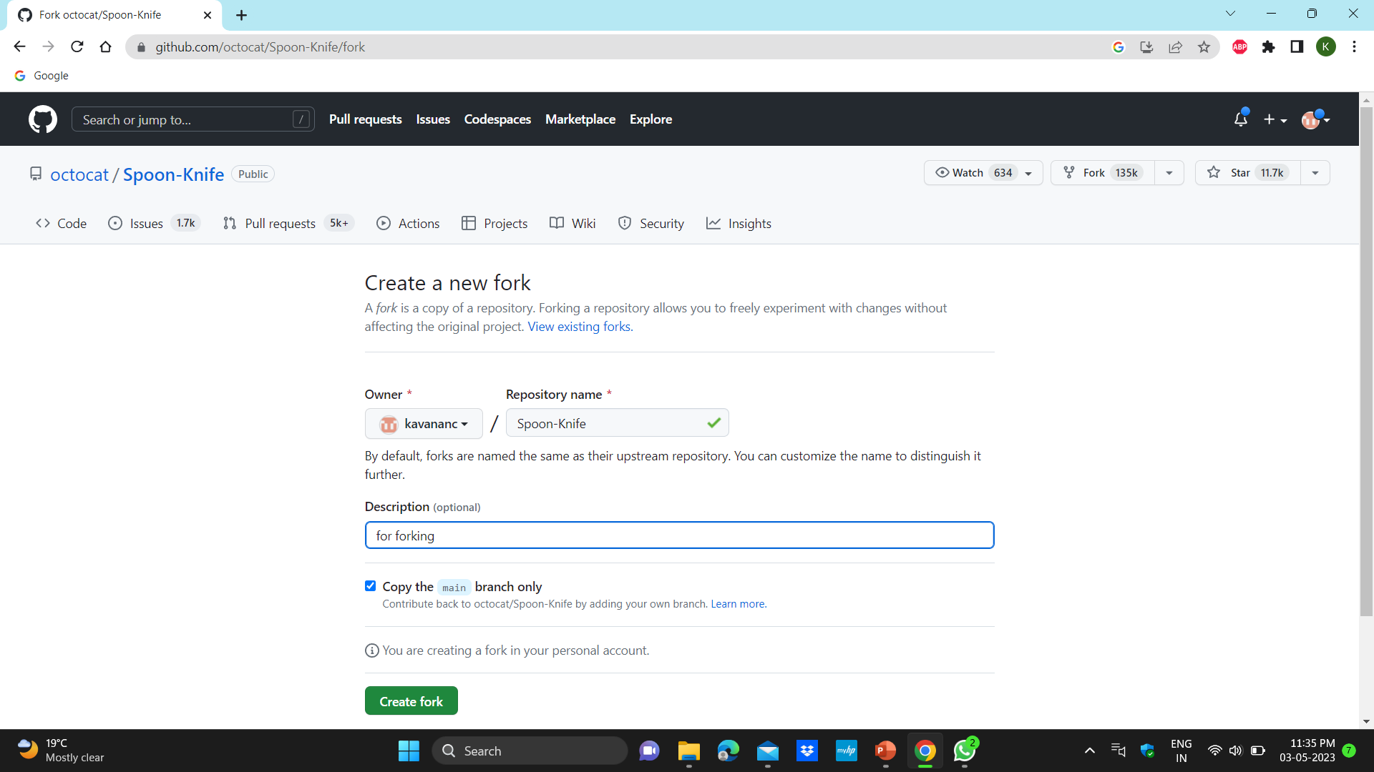
RESULTS AND DISCUSSIONS
Snapshot 4 : By default Repo name

Slide 20
RESULTS AND DISCUSSIONS
Snapshot 5 : Giving description.
Snapshot 5 : By default it selects main branch.

Slide 21
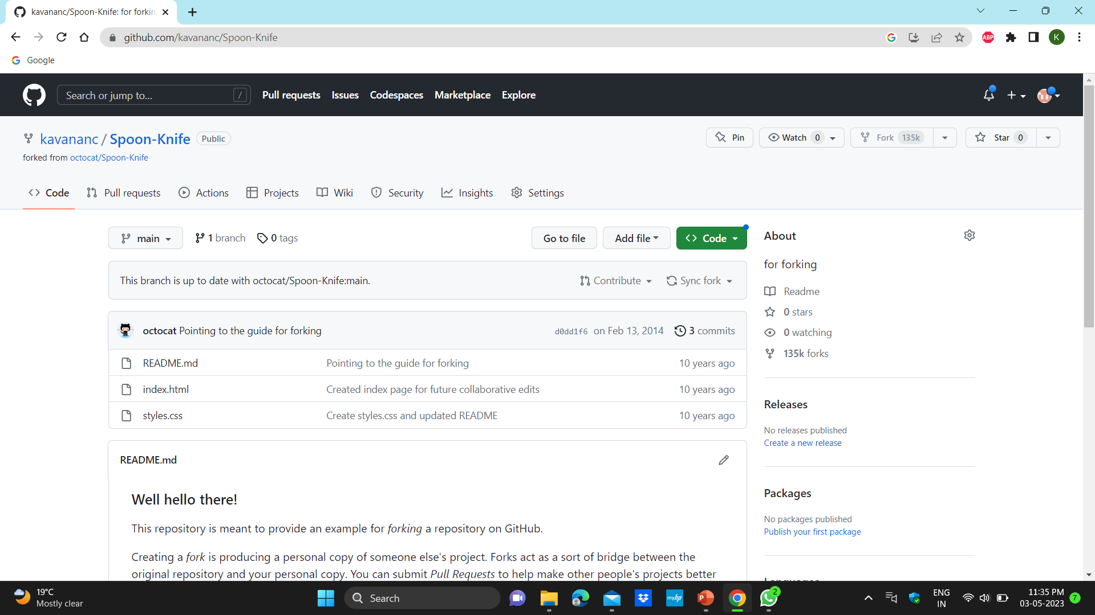
RESULTS AND DISCUSSIONS
Snapshot 6 : creating the fork
Snapshot 7 : Fork represent forked from the repository.

Slide 22
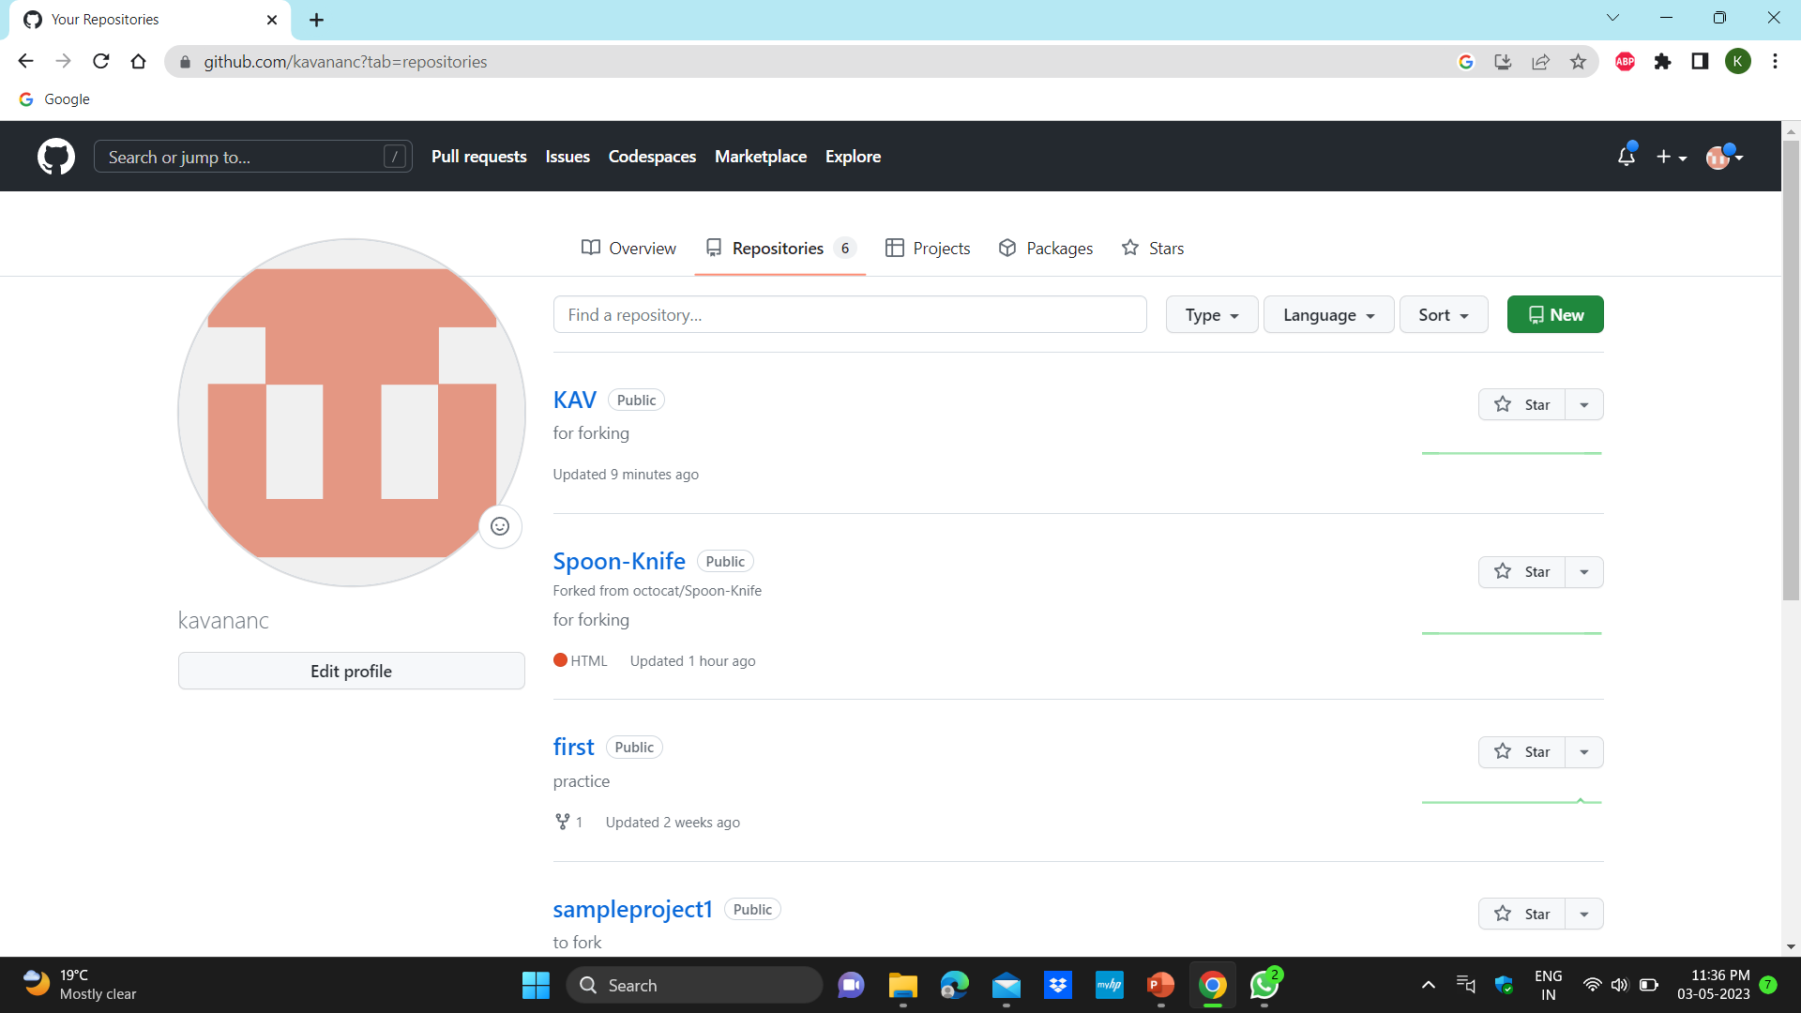
RESULTS AND DISCUSSIONS
Snapshot 8 : The repository is copied to personal account

Slide 23
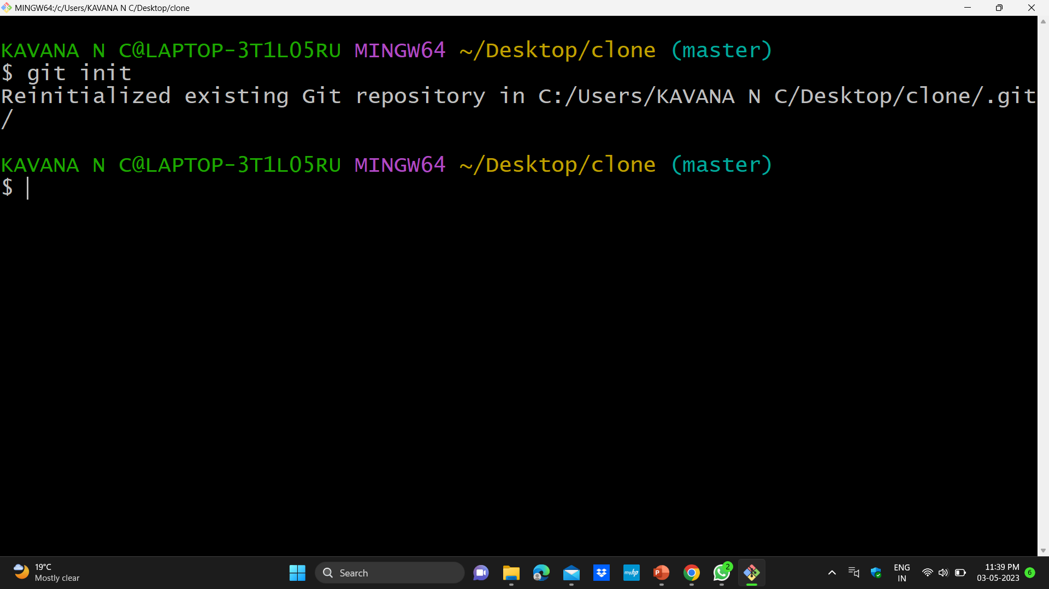
RESULTS AND DISCUSSIONS
CLONING OF THE REPOSITORY
Snapshot 9 : Git Initialization

Slide 24
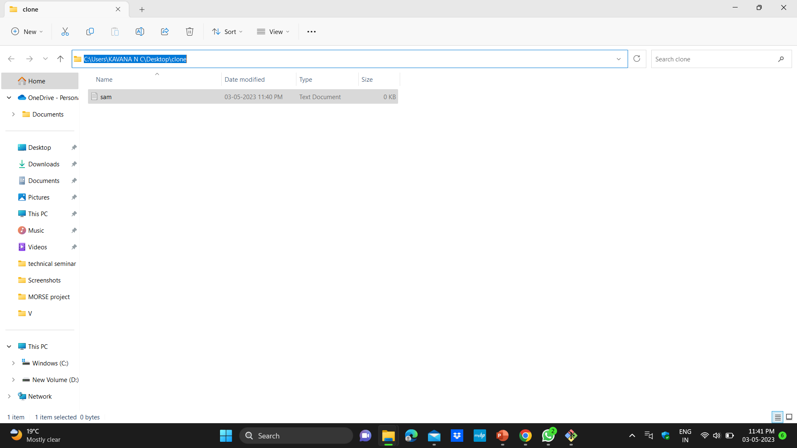
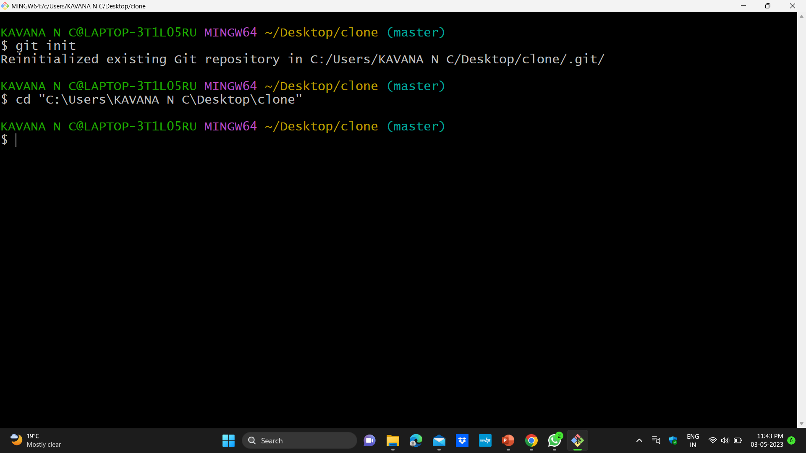
RESULTS AND DISCUSSIONS
Snapshot 10 : coping of the path of the folder created in local repository
Snapshot 11 : pasting the path of the folder created.

Slide 25
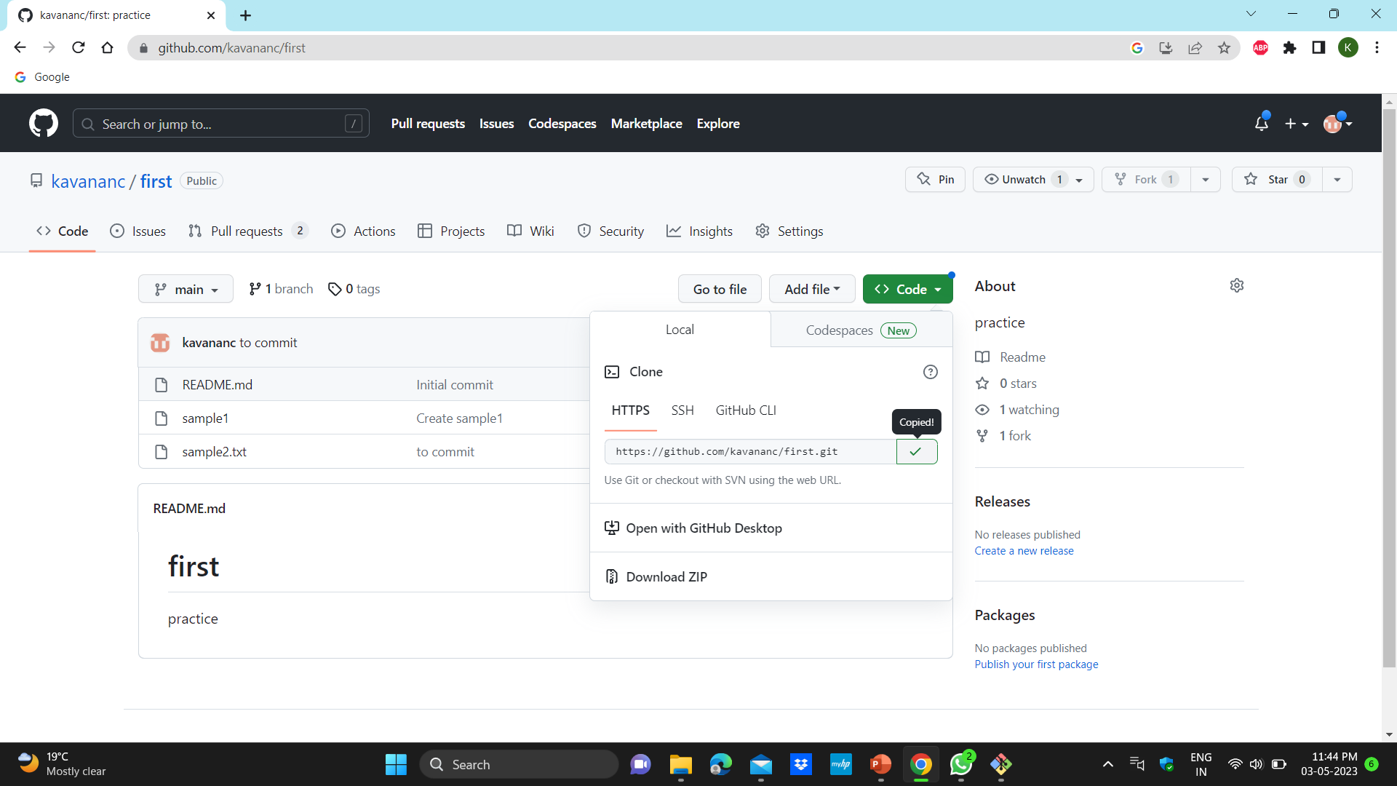
RESULTS AND DISCUSSIONS
Snapshot 12 : coping of the url.

Slide 26
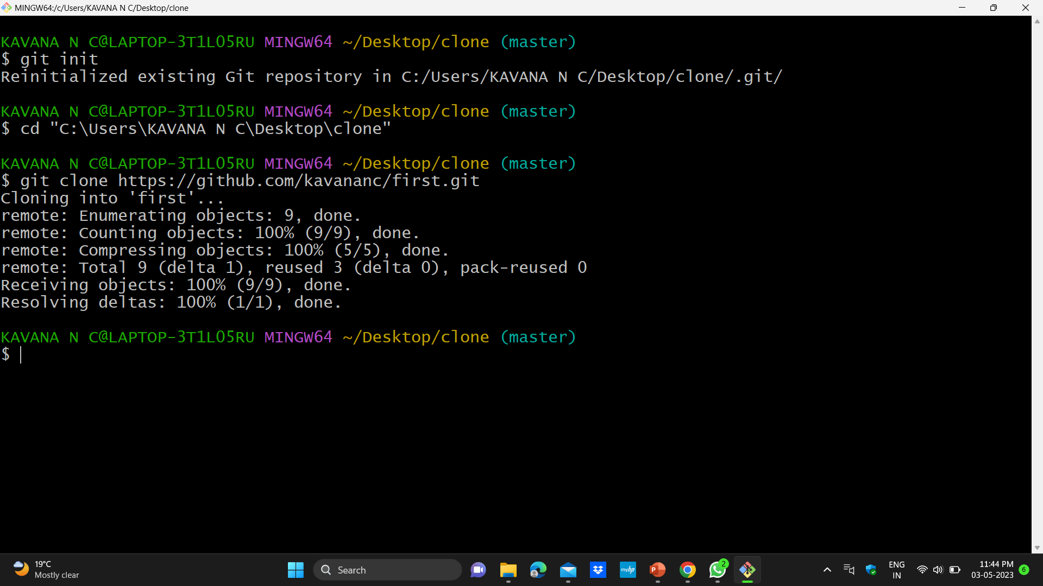
RESULTS AND DISCUSSIONS
Snapshot 13 : Cloning of repository to local system.

Slide 27
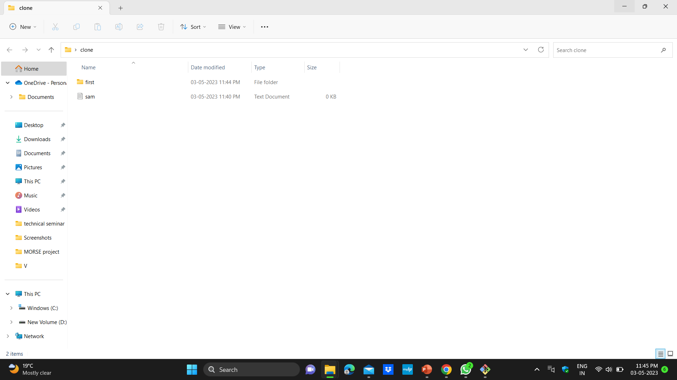
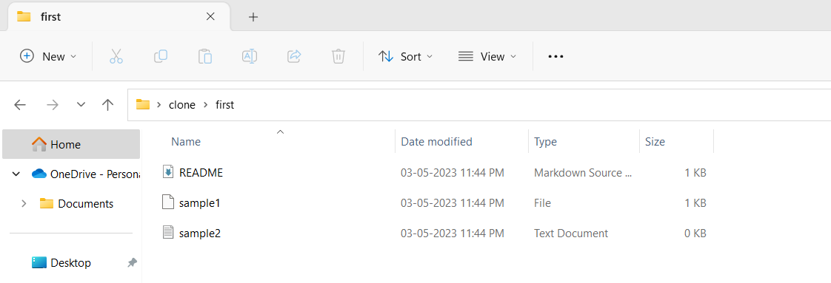
RESULTS AND DISCUSSIONS
Snapshot 14 : The contents are cloned to local system.

Slide 28
CONCLUSION AND FUTURE ENHANCEMENTS
CONCLUSION
GitHub is a powerful platform for collaboration on software development projects.
It allows developers to easily track changes to their code and work together in seamless manner.
Forking helps in changing the contents of the others repository without affecting the original repository.
Cloning a GitHub repository allows the process of local copy of a remote repository.
GitHub and cloning provide essential tools for software development and collaboration.
Making easier for teams to work together and create high quality software products.

Slide 29
CONCLUSION AND FUTURE ENHANCEMENTS
FUTURE ENHANCEMENTS
GitHub already offers great collaboration tools, there is always room for improvement.
It could focus on improving authentication and authorization processes, ensuring data privacy and preventing data breaches.
Cloning a repository is already a straightforward process, but there is still potential to simplify it even further. Enhancements could focus on creating more intuitive interfaces, automating common tasks, and reducing the learning curve for new users.
GitHub and cloning have already revolutionized the software development process, but there is always room for improvement. By focusing on enhancing collaboration, security, workflows, and code analysis, GitHub and cloning can continue to be valuable tools for developers well into the future.

Slide 30
REFERENCES
Creating a repository" documentation from GitHub: https://docs.github.com/en/get-started/quickstart/create-a-repo
"Cloning a repository" documentation from GitHub: https://docs.github.com/en/repositories/creating-and-managing-repositories/cloning-a-repository
"Getting started with GitHub Desktop" tutorial from GitHub: https://docs.github.com/en/desktop/installing-and-configuring-github-desktop/getting-started-with-github-desktop
"How to Clone a Git Repository" tutorial from Atlassian: https://www.atlassian.com/git/tutorials/setting-up-a-repository/git-clone
"Git clone command" documentation from Git: https://git-scm.com/docs/git-clone

